Slide 1


Mini Project “GUARD TALK“ (secure platform for communication)
Dept. of CS&E ( DATA SCIENCE)
Adichunchanagiri Institute of Technology
Chikkamagaluru - 577102
Presented By,
Bhoomika Gowda H G (4AI22CD008)
M M Bhavya (4AI22CD031)
Meghana N.S (4AI22CD034)
Rishitha N (4AI22CD043)
Under the Guidance of
Prof. Shalini I S

Slide 2
PROBLEM STATEMENT
● Overview of the Problem:
This project aims to design and develop a Chat Application, a system that facilitates real-time communication between users, while ensuring an absolute, secure, and scalable experience. It can deliver a vigorous, secure, and scalable solution that provides a smooth and engaging user experience.
●Specific Issues:
• Choosing a suitable datasheet: to store messages, considering factors like scalability, performance, and data integrity.
• Message Expiration:Implementing a mechanism to automatically delete messages after a certain period or when the user exits the chat.

Slide 3
SCOPE OF THE PROJECT
Key Focus Areas:
Real-time messaging between users in a secure environment.
Message starring and storage in an Excel file.
User registration and authentication.
Automatic deletion of messages after a specified period or user exit.
Expected Benefits:
Security: Ensures that user data and messages are secure.
Scalability: The system can accommodate a growing number of users without sacrificing performance.
Usability: An easy-to-use interface for users to send messages and interact with others.
Message Expiry Feature: Messages can automatically expire, keeping the system clean and efficient.

Slide 4
PROJECT DESIGN
System Components:
Frontend: Built using Flet (Python framework) for interactive and responsive UI.
Backend: User management and message storage logic.
Database: Using an Excel sheet to store starred messages.
Real-Time Communication: Using the Pub/Sub model for broadcasting messages.
Architecture/Block Diagram:
User Interface: Sign in, sign up, chat interface.
Message Handling: Sending, receiving, starring, and message expiration.
Database Management: Storing starred messages in an Excel sheet.
Backend: Logic to handle user authentication, message storage, and expiration.

Slide 5
METHODOLOGY
Steps/Approach:
User Registration and Login: Users sign up or log in using credentials stored in a simple database.
Real-Time Messaging: Messages are sent in real-time, with instant updates to users.
Message Starring and Storage: Users can star important messages, which are saved to an Excel file.
Message Expiration: Messages expire after a certain period or when the user logs out.
Tools and Technologies Used:
Flet Framework for real-time messaging UI.
Python for backend logic and server-side processing.
Openpyxl for managing starred messages in Excel.
SQLite/Excel for user and message storage.
Pub/Sub model for real-time communication

Slide 6
IMPLEMENTATION
Code Highlights:
Message Class: Manages the attributes of each message (user, text, starred status).
ChatMessage Class: Controls the layout of individual messages and the interaction (starring and un-starring).
Excel Integration: Code to save and update starred messages in an Excel file.
Message Expiration: Logic to delete messages after a certain time or when a user logs out.
Backend Implementation:
• This file defines a class UsersDB that simulates a user database. It contains a list of dictionaries representing users with their usernames and passwords.
• read_db: This function checks if a given username and password combination exists in the users_list. It returns True if a match is found, False otherwise.
• write_db: This function adds a new user with the provided username and password to the users_list. It returns True if successful.

Slide 7
Frontend Implementation:
• main.py:
This is the main entry point for the application. It defines several functions for handling user interactions and manages the application state.
• sign_in and sign_up:
These functions call the corresponding methods in UsersDB to authenticate users. Upon successful login, it sets a user session and redirects to the chat view.
• on_message:
This function handles incoming messages received through the Flet pub/sub mechanism. It renders the message based on its type (chat message or login message).
• send_message_click:
This function sends the user's message through the pub/sub channel.
• toggle_star:
This function toggles the starred state of a message and updates the starred message list (stored in a global dictionary starred_messages).

Slide 8
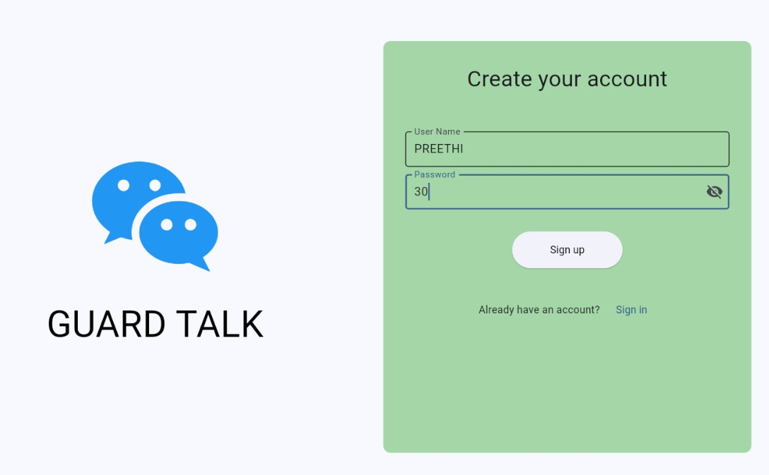
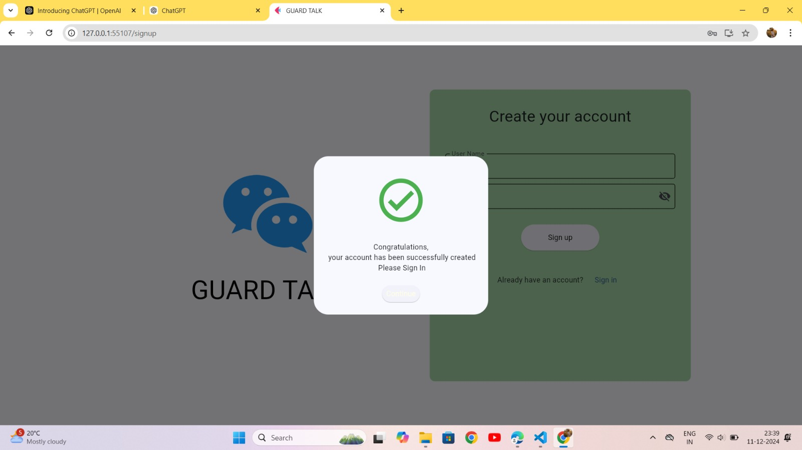
• save_to_excel:
This function (not used in the current implementation) saves starred messages for a user to an Excel file.
• signin_form.py and signup_form.py: These files define reusable user controls for the sign-in and sign-up forms. They handle user input, validation, and call the appropriate functions in main.py to submit the form.
Screenshots/Snippets:

Slide 9
RESULTS
Output/Outcomes:
Real-time chat system implemented with user authentication and message handling.
Users can star messages, and the system tracks these in an Excel file.
Messages automatically expire as per the set time, or when the user logs out.
Illustrations/Graphs:
Chat Interface Screenshot showing the user interaction and message sending.
Excel File: Screenshot showing saved starred messages with timestamps.
(both are given below)

Slide 10
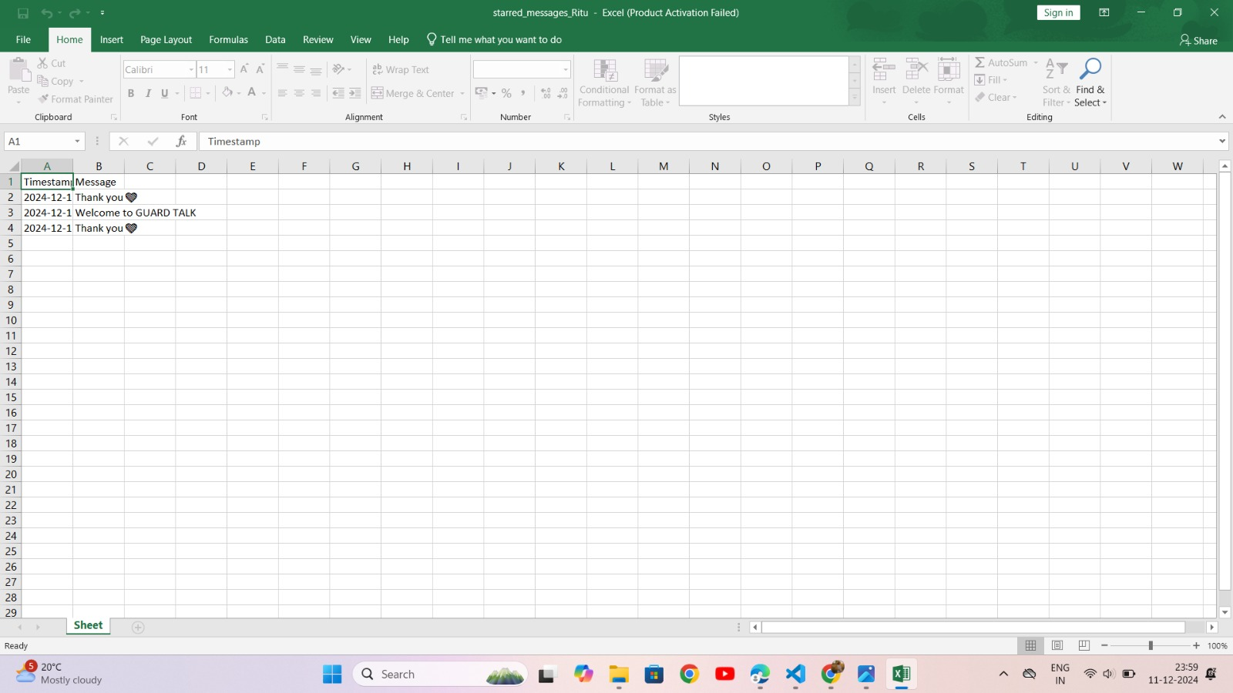
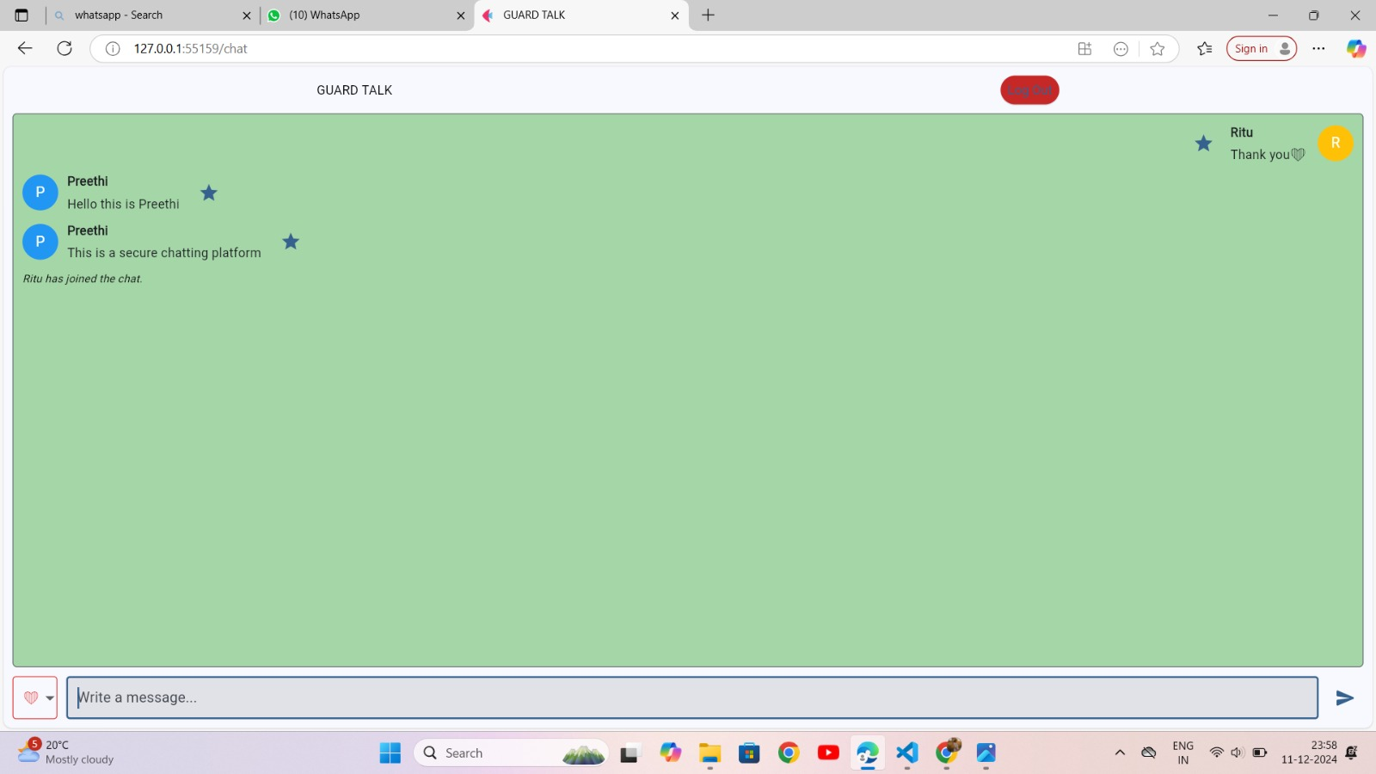

Slide 11
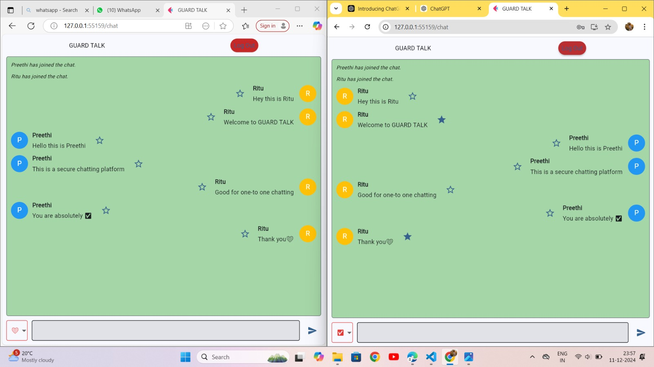

Slide 12
CHALLENGES FACED
Challenges:
Real-Time Message Delivery: Implementing an efficient and fast system for real-time message broadcasting.
Message Expiration: Ensuring messages are deleted on time, particularly when handling multiple users.
Data Integrity: Managing the consistency of starred messages and ensuring they are saved correctly in the Excel sheet.
Resolutions:
Used Pub/Sub model for fast message delivery and real-time updates.
Implemented background tasks to manage message expiration after a set period.
Used Openpyxl to efficiently manage data and ensure data integrity in the Excel file.

Slide 13
FUTURE WORK
.
Enhancements:
Multi-device Support: Allowing users to access their messages across multiple devices.
Push Notifications: Adding push notifications for new messages when users are not active on the app.
Voice and Video Calls: Integrate real-time voice and video calling capabilities for richer communication.
Offline Messaging: Store and deliver messages to users even when they are offline, ensuring uninterrupted communication.
Integration:
Plan to integrate End-to-End Encryption for enhanced security of user data and messages.
Excel to power Bi Integration: Seamlessly connect Excel Spreadsheet to Power BI to analyze and visualize numerical data such as message activity, user engagement and system performance matrics.

Slide 14
CONCLUSION
Summary:
Developed a secure, scalable real-time messaging system with features like message starring and expiration.
Addressed key challenges related to real-time communication, data integrity, and message expiration.
Outcome:
A fully functional chat system ready for future enhancements like multi-device support and improved security features.
Final Thought:
This project demonstrates the potential of building real-time communication systems that are both scalable and secure, making it suitable for various use cases, including enterprise and personal communication.

Slide 15
GIT HUB LINK

